Slide 1
Overview of AD DS

Slide 2
Executive summary
Active Directory Domain Services (AD DS) and its related services form the foundation for enterprise
networks that run Windows operating systems. The AD DS database is the central store of all the domain
objects, such as user accounts, computer accounts, and groups. AD DS provides a searchable, hierarchical
directory and a method for applying configuration and security settings for objects in the enterprise.
The AD DS database (Ndts.dit) stores information on user identity, computers, groups, services, and resources in a hierarchical structure, called the directory. AD DS domain controllers also host the service that authenticates
user and computer accounts when they sign in to the domain. Because AD DS stores information about all
domain objects, and because all users and computers must connect to AD DS domain controllers at sign-in,
AD DS is the primary way to configure and manage user and computer accounts on your network.
SYSVOL folder
Source: …

Slide 3
Agenda
AD DS components
AD DS schema
AD DS Forest
AD DS Domain
OUs
What’s new in AD DS in Windows Server 2016
Azure AD
Overview of AD DS administration tools

Slide 4
Agenda
AD DS components
AD DS schema
AD DS Forest
AD DS Domain
OUs
What’s new in AD DS in Windows Server 2016
Azure AD
Overview of AD DS administration tools

Slide 5
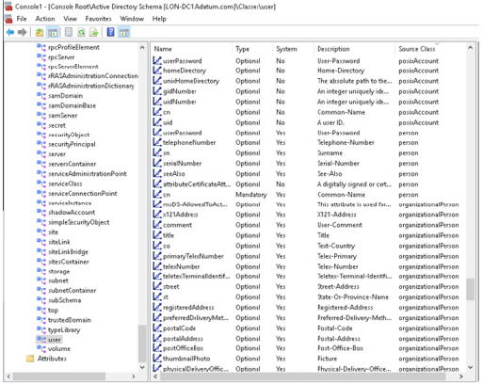
The AD DS schema is the component that defines
all the object classes and attributes that AD DS
uses to store data. All domains in a forest contain a
copy of the schema that applies to that forest. Any
change in the schema replicates to every domain
controller in the forest from the schema master,
which is typically the first domain controller in the
forest.
AD DS stores and retrieves information from a
wide variety of applications and services. It does
this, in part, by standardizing how the AD DS
directory stores data. By standardizing data
storage, AD DS can retrieve, update, and replicate data while helping to maintain data integrity.

Slide 6
Objects
AD DS uses objects as units of storage. The schema defines all object types. Each time the directory handles
data, the directory queries the schema for an appropriate object definition. Based on the object definition
in the schema, the directory creates the object and stores the data.
Object definitions specify both the types of data that the objects can store and the syntax of the data. You
can create only objects that the schema defines. Because objects store data in a rigidly defined format,
AD DS can store, retrieve, and validate the data that it manages, regardless of which application supplies it.
Relationships among objects, rules, attributes, and classes
In AD DS, the schema defines the following:
• Objects that store data in the directory
• Rules that define the structure of the objects
• The structure and content of the directory itself
AD DS schema objects consist of attributes, which are grouped together into classes. Each class has rules
that define which attributes are mandatory and which are optional. For example, the user class consists of
more than 400 possible attributes, including cn (the common name attribute), givenName, displayName,
objectSID, and manager. Of these attributes, the cn and objectSID attributes are mandatory.

Slide 7
Changing the schema
Only members of the Schema Admins group can modify the AD DS schema. You cannot remove anything
from the AD DS schema. You can only extend the AD DS schema by using AD DS schema extensions or by
modifying the attributes of existing objects. For example, when you are preparing to install Microsoft
Exchange Server 2016, you must apply the Exchange Server 2016 Active Directory schema changes. These
changes add or modify hundreds of classes and attributes.
You should change the schema only when necessary, because the schema controls the storage of
information. Any changes made to the schema affect every domain controller. Before you change the
schema, you should review the changes and implement them only after you have performed testing.
This will help ensure that the changes will not adversely affect the rest of the forest or any applications that
use AD DS.
The schema master is one of the operations master roles hosted on a single domain controller in AD DS.
Because it is a single master, you must use the Active Directory Schema snap-in to make changes to the
schema by targeting the domain controller that holds the schema master. To target the schema master in a
separate forest, you will need to target the appropriate forest from within the snap-in.

Slide 8
Agenda
AD DS components
AD DS schema
AD DS Forest
AD DS Domain
OUs
What’s new in AD DS in Windows Server 2016
Azure AD
Overview of AD DS administration tools

Slide 9
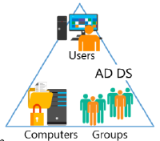
AD DS forest
A forest is a top-level container in AD DS. Each forest is a collection of one or more domain trees that share a common directory schema and a global catalog.
A domain tree is a collection of one or more domains that share a contiguous namespace.
The first domain that you create in the forest is called the forest root domain. The forest root domain contains a few objects that do not exist in other domains in the forest. Because you always create these objects on the first domain controller, a forest can consist of as few as one domain with a single domain controller, or it can consist of hundreds of domains across multiple domain trees.

Slide 10
Security boundary
An AD DS forest is a security boundary. By default, no users from outside the forest can access any
resources inside the forest. Typically, an organization creates only one forest, although you can create
multiple forests to isolate administrative permissions among different parts of the organization.
By default, all the domains in a forest automatically trust the other domains in the forest. This makes it easy
to enable access to resources, such as file shares and websites, for all the users in a forest, regardless of the
domain to which they belong.
Replication boundary
An AD DS forest is the replication boundary for the configuration and schema partitions in the AD DS
database. As a result, all the domain controllers in the forest must share the same schema. Because of this,
organizations that want to deploy applications with incompatible schemas need to deploy additional
forests.
The AD DS forest is also the replication boundary for the global catalog. The global catalog makes it
possible to find objects from any domain in the forest. For example, the global catalog is used whenever
user principal name (UPN) sign-in credentials are used or when Microsoft Exchange Server address books
are used to find users.

Slide 11
The following objects exist only in the forest root domain:
The schema master role. This is a special, forest-wide domain controller role. Only one schema master exists in any forest. You can change the schema only on the domain controller that holds the schema master.
The domain naming master role. This is also a special, forest-wide domain controller role. Only one domain naming master exists in any forest. Only the domain naming master can add new domain names to the directory.
The Enterprise Admins group. By default, the Enterprise Admins group has the Administrator account for the forest root domain as a member. The Enterprise Admins group is a member of the local Administrators group in every domain in the forest. This allows members of the Enterprise Admins group to have full control administrative rights to every domain throughout the forest.
The Schema Admins group. By default, the Schema Admins group has no members. Only members of the Enterprise Admins group or the Domain Admins group (in the forest root domain), can add members to the Schema Admins group. Only members of the Schema Admins group can make changes to the schema.

Slide 12
Agenda
AD DS components
AD DS schema
AD DS Forest
AD DS Domain
OUs
What’s new in AD DS in Windows Server 2016
Azure AD
Overview of AD DS administration tools

Slide 13
Agenda
AD DS components
AD DS schema
AD DS Forest
AD DS Domain
OUs
What’s new in AD DS in Windows Server 2016
Azure AD
Overview of AD DS administration tools

Slide 14
Agenda
AD DS components
AD DS schema
AD DS Forest
AD DS Domain
OUs
What’s new in AD DS in Windows Server 2016
Azure AD
Overview of AD DS administration tools

Slide 16
Agenda
AD DS components
AD DS schema
AD DS Forest
AD DS Domain
OUs
What’s new in AD DS in Windows Server 2016
Azure AD
Overview of AD DS administration tools

Slide 17
Azure AD
Azure AD is a service that provides identity management and access control for your cloudbased
applications. You use Azure AD when you subscribe to Microsoft Office 365, Microsoft SharePoint Online, Exchange Online, or Skype for Business. Additionally, you can use Azure AD with Azure apps or Internet-connected apps that require authentication. You can synchronize your on-premises AD DS with Azure AD to allow your users to use the same identity across both internal resources and cloud-based resources.
Azure AD does not include all the services available with an on-premises Active Directory solution that uses Windows Server 2016
Azure AD does not support applications that are integrated with on-premises Active Directory. For applications to integrate with Azure AD, they must be Azure AD–specific.
On-premises AD in Windows Server 2016 supports 5 services | Azure AD includes only
AD DS | Azure AD, which supports identity management in the cloud.
AD FS | Azure Access Control Service, which supports federation with external identity management services, including your on-premises instance of AD DS.
Active Directory Lightweight Directory Services (AD LDS)
Active Directory Certificate Services (AD CS)
Active Directory Rights Management Services (AD RMS)

Slide 18
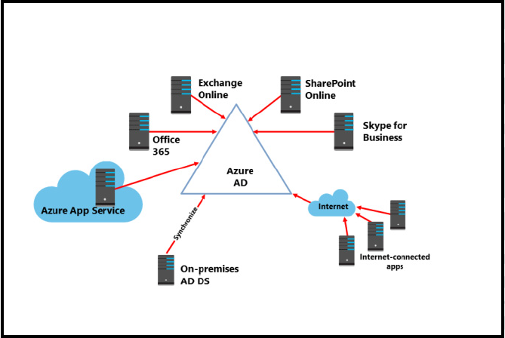
Azure AD
You cannot create AD DS domain controllers in Azure AD. You can use Azure AD as a standalone service or integrate it with your existing on-premises Active Directory infrastructure. However, you do not create or manage the Azure AD systems. Instead, you manage your users in the Azure AD service.

Slide 19
Agenda
AD DS components
AD DS schema
AD DS Forest
AD DS Domain
OUs
What’s new in AD DS in Windows Server 2016
Azure AD
Overview of AD DS administration tools

Slide 20
Overview of AD DS administration tools
Active Directory Administrative Center
The Active Directory Administrative Center provides a graphical user interface (GUI) that is Windows PowerShell–based. This enhanced interface allows you to perform AD DS object management by using task-oriented navigation, and it replaces the functionality of Active Directory Users and Computers.
Tasks that you can perform by using the Active Directory Administrative Center include:
• Creating and managing user, computer, and group accounts.
• Creating and managing OUs.
• Connecting to and managing multiple domains within a single instance of the Active Directory Administrative Center.
• Searching and filtering AD DS data by building queries.
• Creating and managing fine-grained password policies.
• Recovering objects from the Active Directory Recycle Bin.
• Managing objects that the Dynamic Access Control feature requires.

Slide 21
Overview of AD DS administration tools
Other management tools
• Active Directory Users and Computers. is a Microsoft Management Console (MMC) snap-in that manages most common resources, including users, groups, and computers. Although many administrators are familiar with this snap-in, the Active Directory Administrative Center replaces it and provides more capabilities.
• Active Directory Sites and Services. The Active Directory Sites and Services MMC snap-in manages
replication, network topology, and related services.
• Active Directory Domains and Trusts. The Active Directory Domains and Trusts MMC snap-in configures and maintains trust relationships at the domain and forest functional levels.
• Active Directory Schema snap-in. The Active Directory Schema MMC snap-in examines and modifies the definitions of AD DS attributes and object classes. You typically do not view or change it very often.
Therefore, by default, the Active Directory Schema snap-in is not fully installed.
• Active Directory module for Windows PowerShell. The Active Directory module for Windows PowerShell supports AD DS administration, and it is one of the most important management components. Server Manager and the Active Directory Administration Center are Windows PowerShell–based and use cmdlets to perform their tasks.

